Slide 1
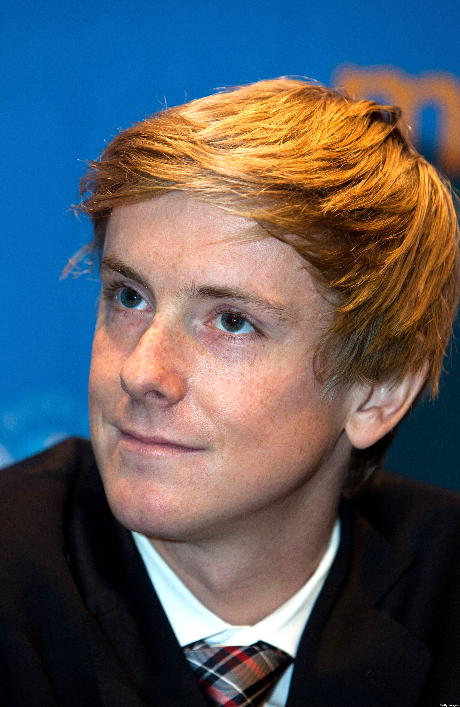

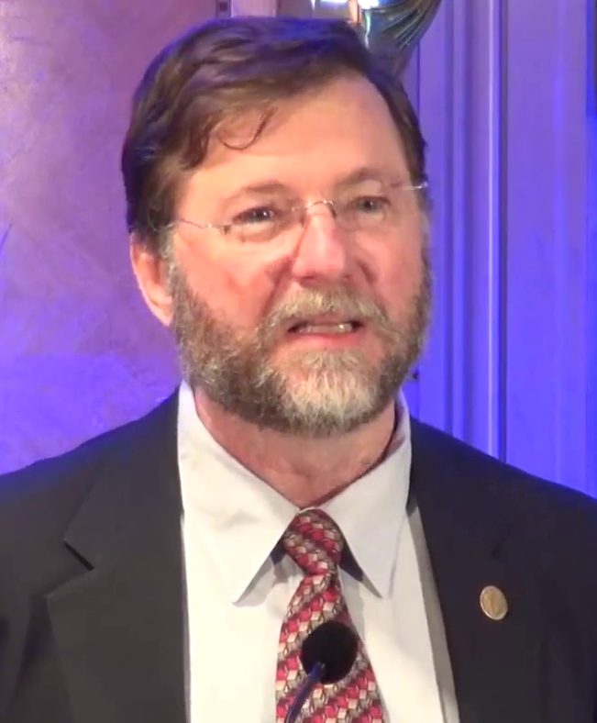
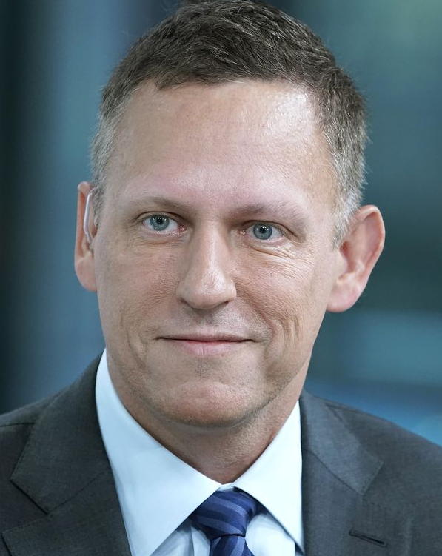
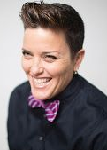
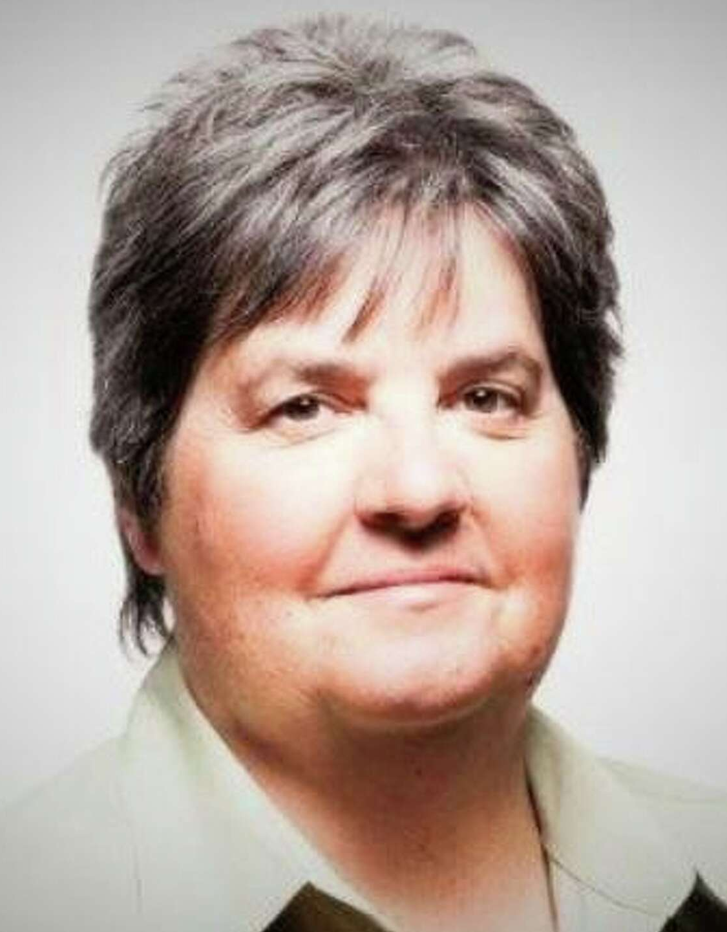
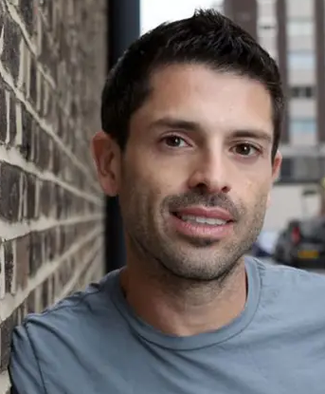
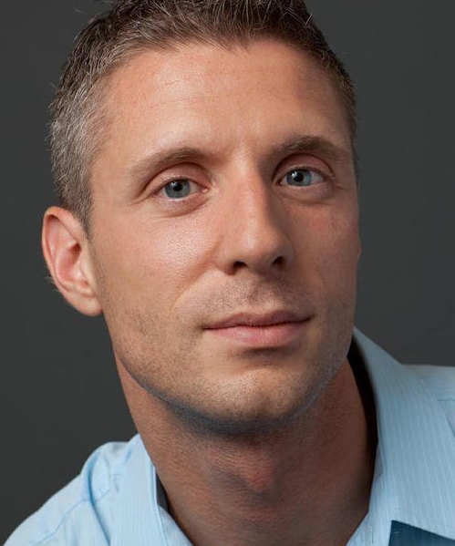
Chris Hughes:
Engineer and Facebook co-founder
Tim Cook:
Engineer and Apple CEO
Eric Allman: Inventor of sendmail and syslog systems
Peter Thiel: Tech investor & founder of Y Combinator
Sara Sperling: Facebook and Snapchat exec
Lisa Brummel: Microsoft VP of HR
Joel Simkhai: Social network entrepreneur
Lorenzo Thione: Founder of Bing predecessor
LGBT History Month Software Engineering luminaries honorable mentions (Photos: Bing)

Slide 2
Software Testing Exercise
JD Kilgallin
CPSC:480
11/02/22

Slide 3
Exercise
Clone the GitHub repo at https://github.com/kilgallin/SWEF22-Exercise-6
Create a branch named after your UANET Id.
Compute the cyclomatic complexity and runtime of each two-sum method and record the result in the provided comment above the function.
Write unit tests using the framework provided to verify behavior of the three two-sum methods.
Run the tests and check the code coverage and pass rate.
For any tests that don’t give the correct result on all methods, examine the two-sum method that’s failing and identify the cause of the failure.
Correct the failure(s) in the method so that all tests pass.
Ensure that you have 100% code coverage and 100% pass rate.
Commit & push your branch (git push --set-upstream origin <branch>)
Issue a pull request to main. Do not commit or merge to main.

Slide 4
Details
Make sure to keep TESTBRANCH statements everywhere they belong.
Make sure to keep the branchCount up to date.
Make sure to register each test as described.
Make sure to run each test.
Make sure you understand the specification of two-sum.
Make sure to review pass rate and branch coverage rate.
Make sure to submit the pull request with your work by Friday.
Make sure not to commit, push, or merge to main.
Up to 10% extra credit for improvements to infrastructure code. Do this in a separate commit and pull request.

